Slide 1

EEG2Music-Spec: Reconstructing Music Stimuli From Acoustic Brain Responses
Adolfo G. Ramirez-Aristizabal
University of California Merced

Slide 2
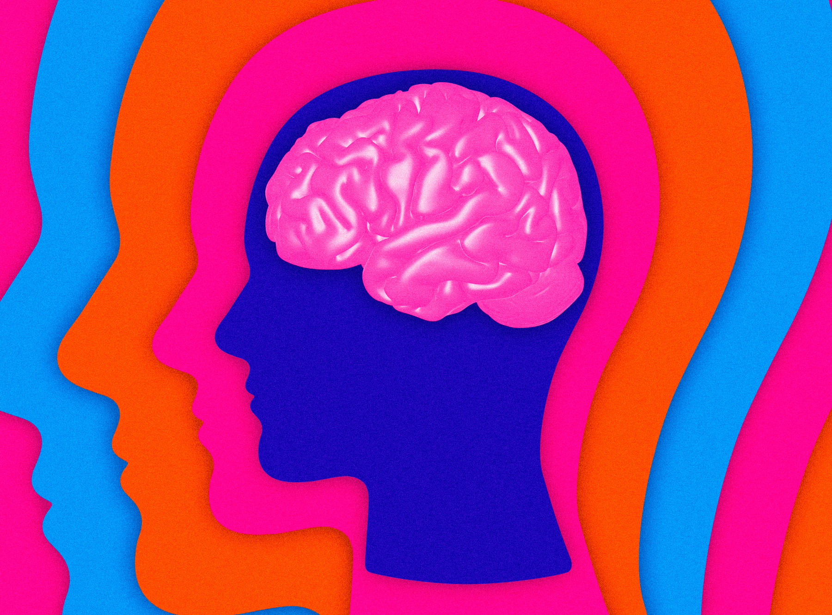
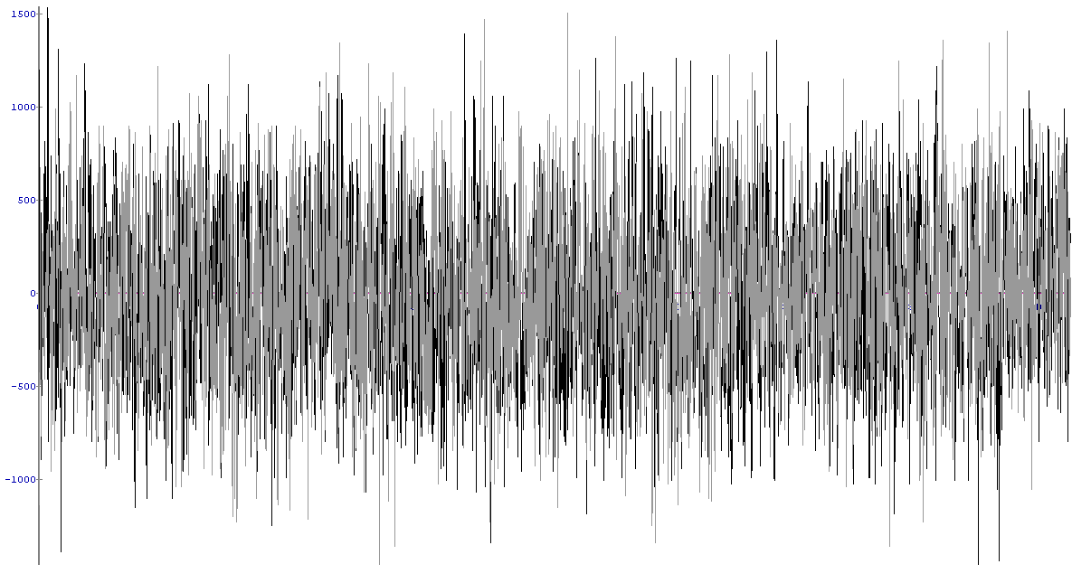
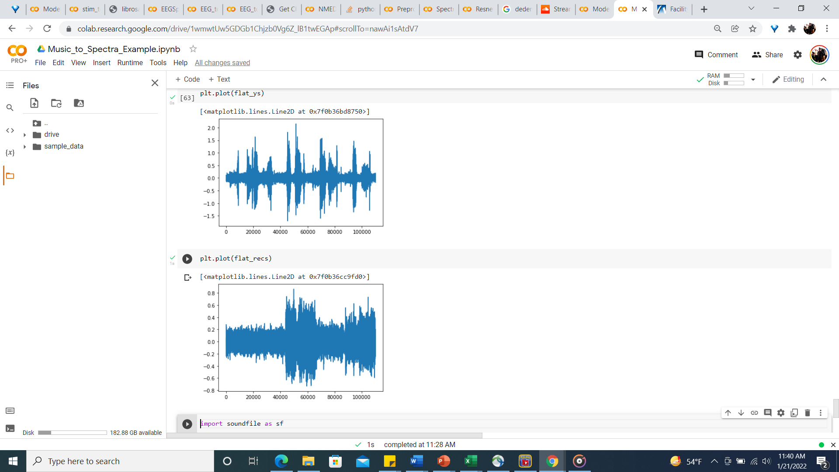
Brain Response
Music Stimuli

Slide 3
Naturalistic Music Electroencephalogram Dataset - Hindi
4 pop songs in Hindi
12 Participants
2 Listening sessions
4 minute recordings
Citation
Kaneshiro, B., Nguyen, D. T., Dmochowski, J. P., Norcia, A. M., & Berger, J. (2016). Naturalistic music EEG dataset—hindi (nmed-h).
In Stanford Digital Repository.. Stanford Digital Repository.
Link
https://exhibits.stanford.edu/data/catalog/sd922db3535

Slide 4
Model
Deep CNN Regressor
x5 2D Convolutional Layers
x1 Max Pooling Layer
x2 Dense Layers
Output Layer Size of Spectral Target
Parameters: ~ 9,800,000

Slide 5
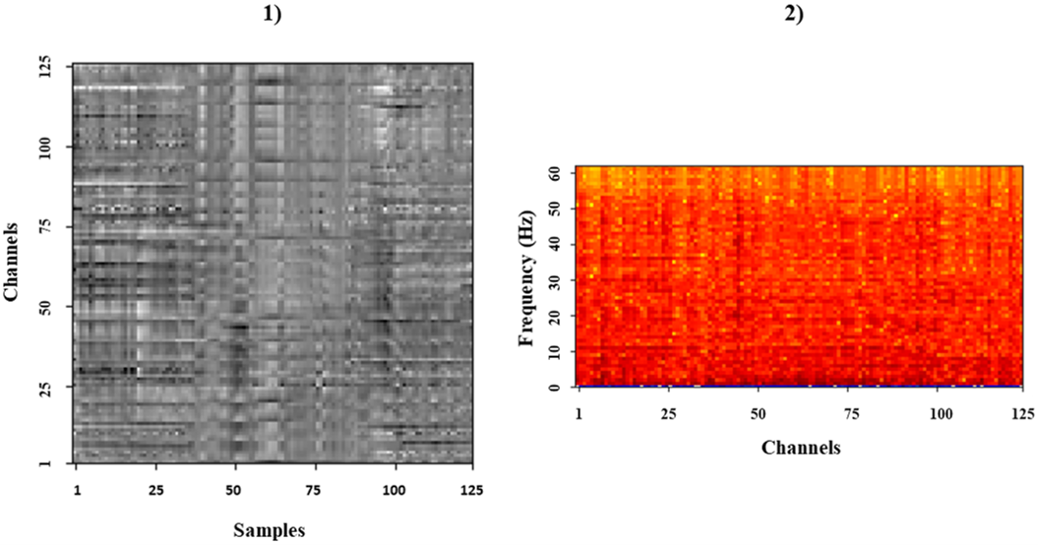
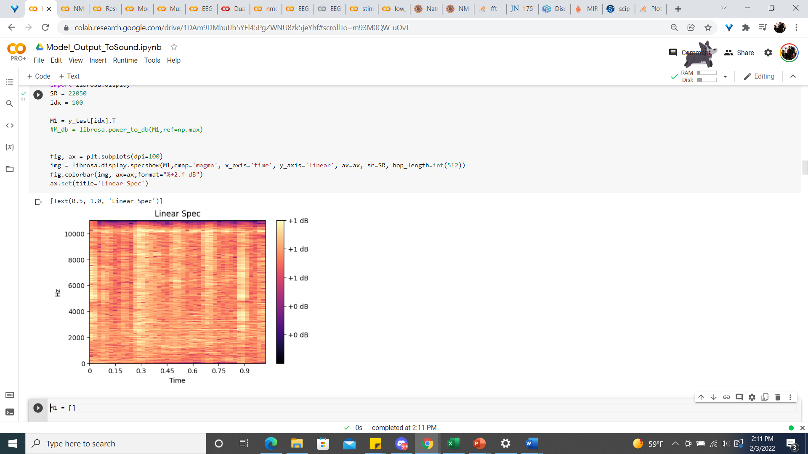
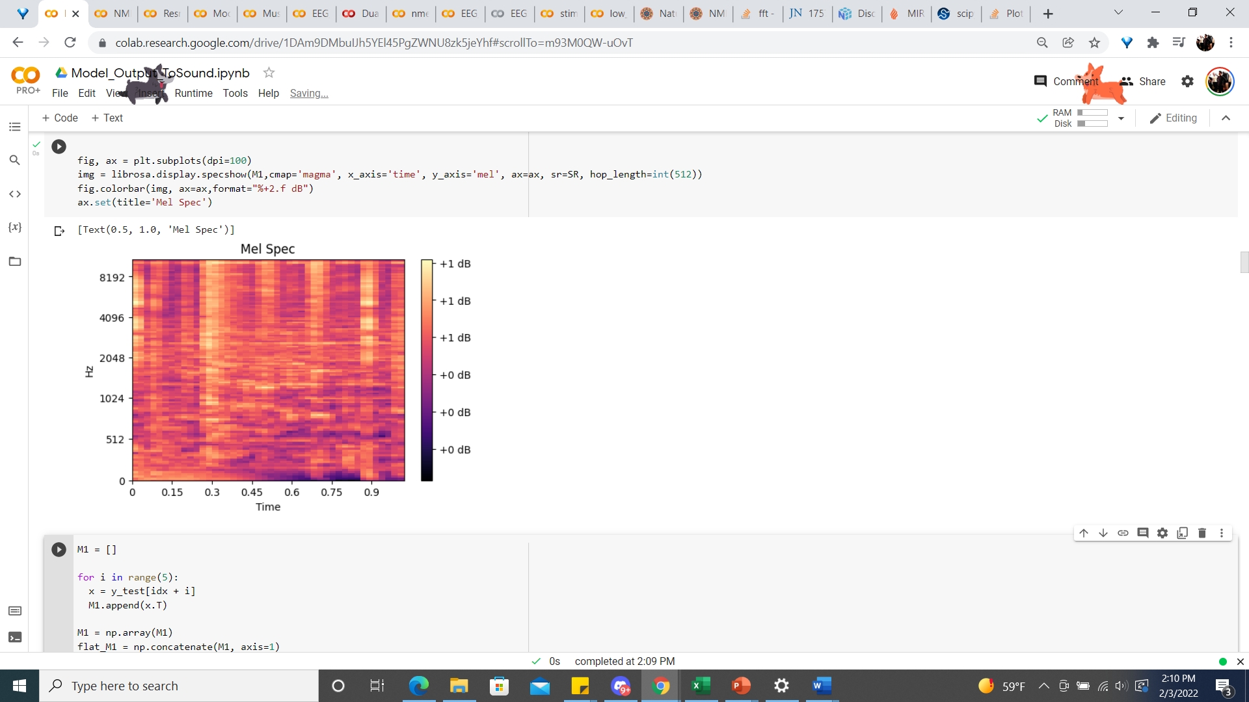
Raw
Gray-Linear
Gray-Mel
PSD
PSD-Linear
PSD-Mel

Slide 6

SONG #1
Ainvayi Ainvayi - Salim Merchant & Sunidhi Chauhan

Slide 7
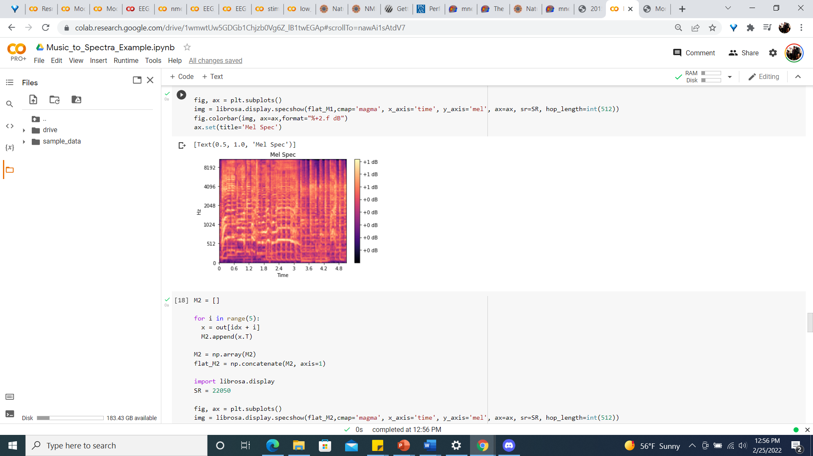
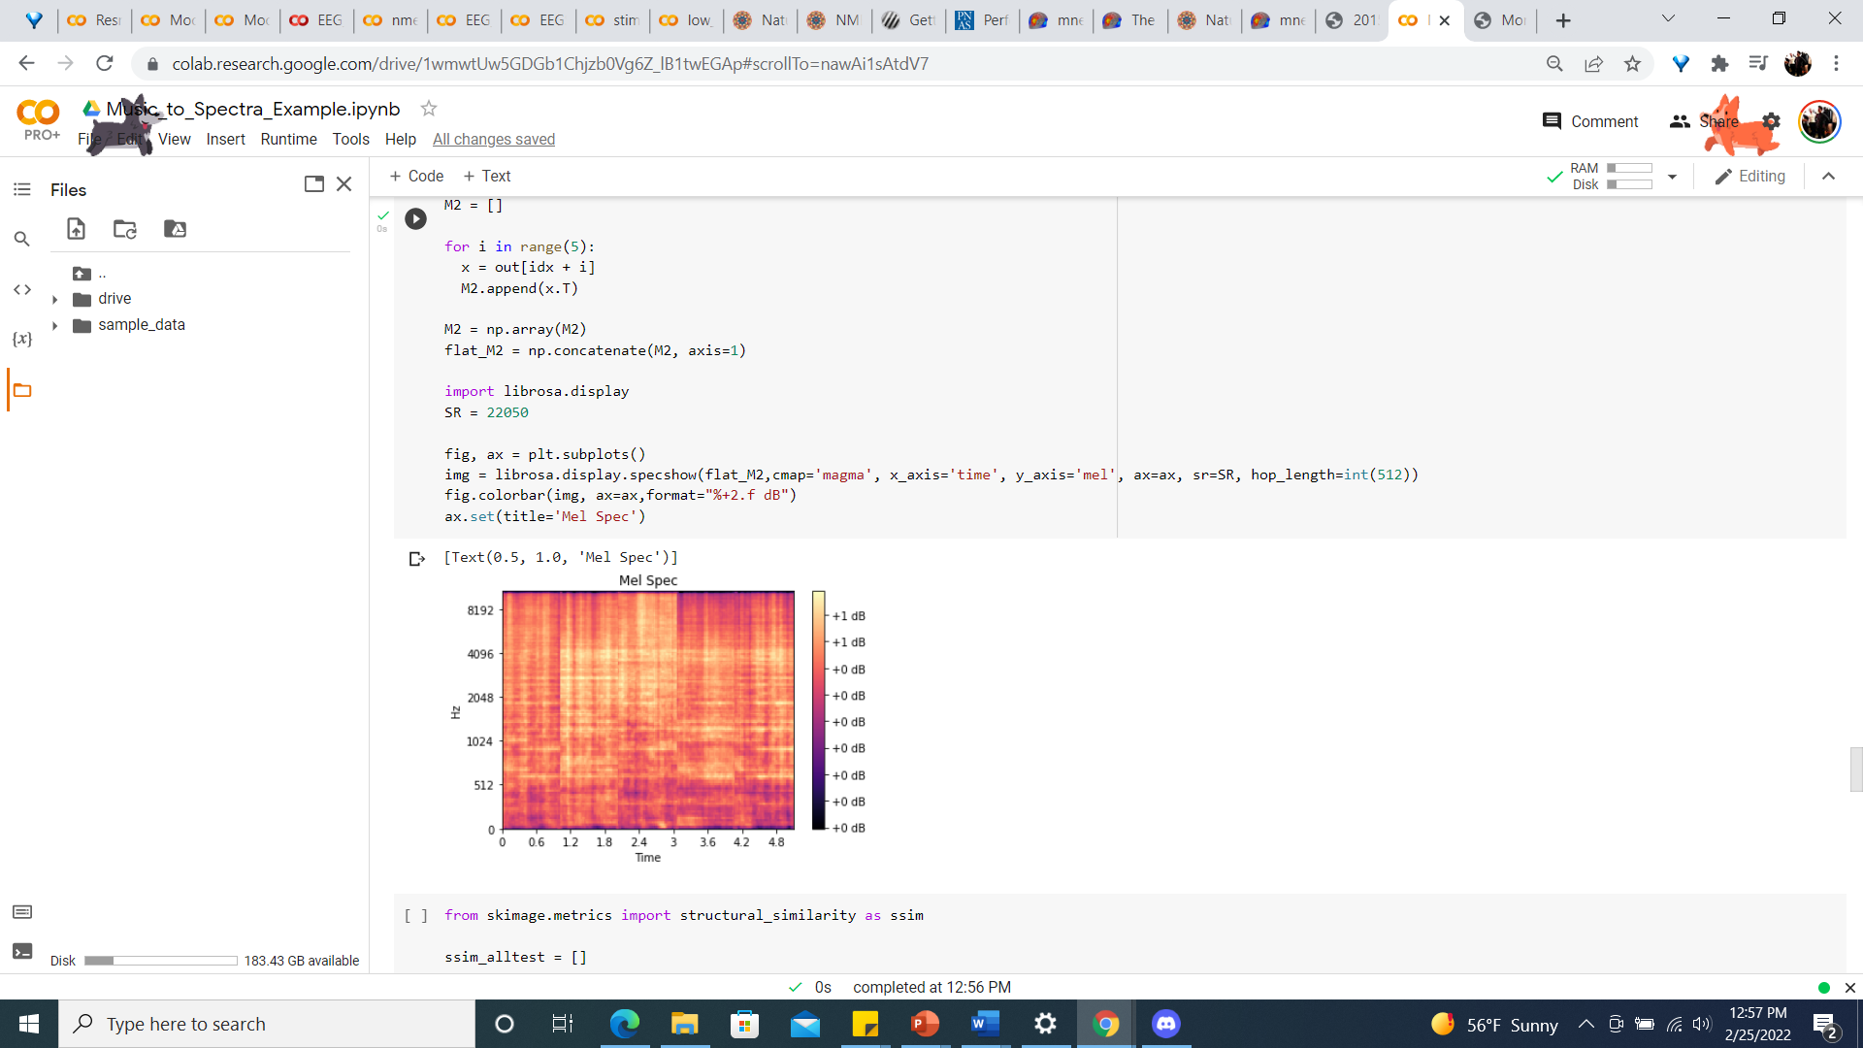
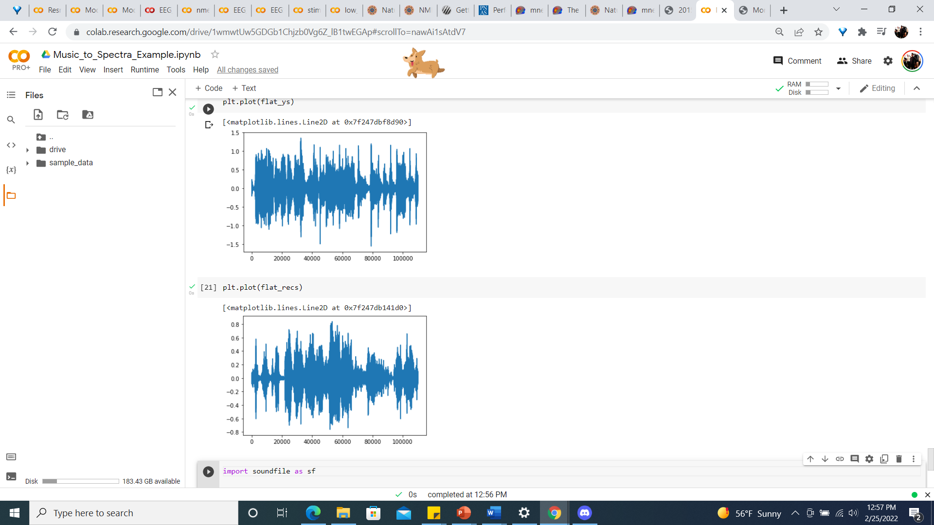

Stimuli
Model Reconstruction From Brain Response

Slide 8

SONG #2
Daaru Desi - Benny Dayal & Shalmali Kholgade

Slide 9
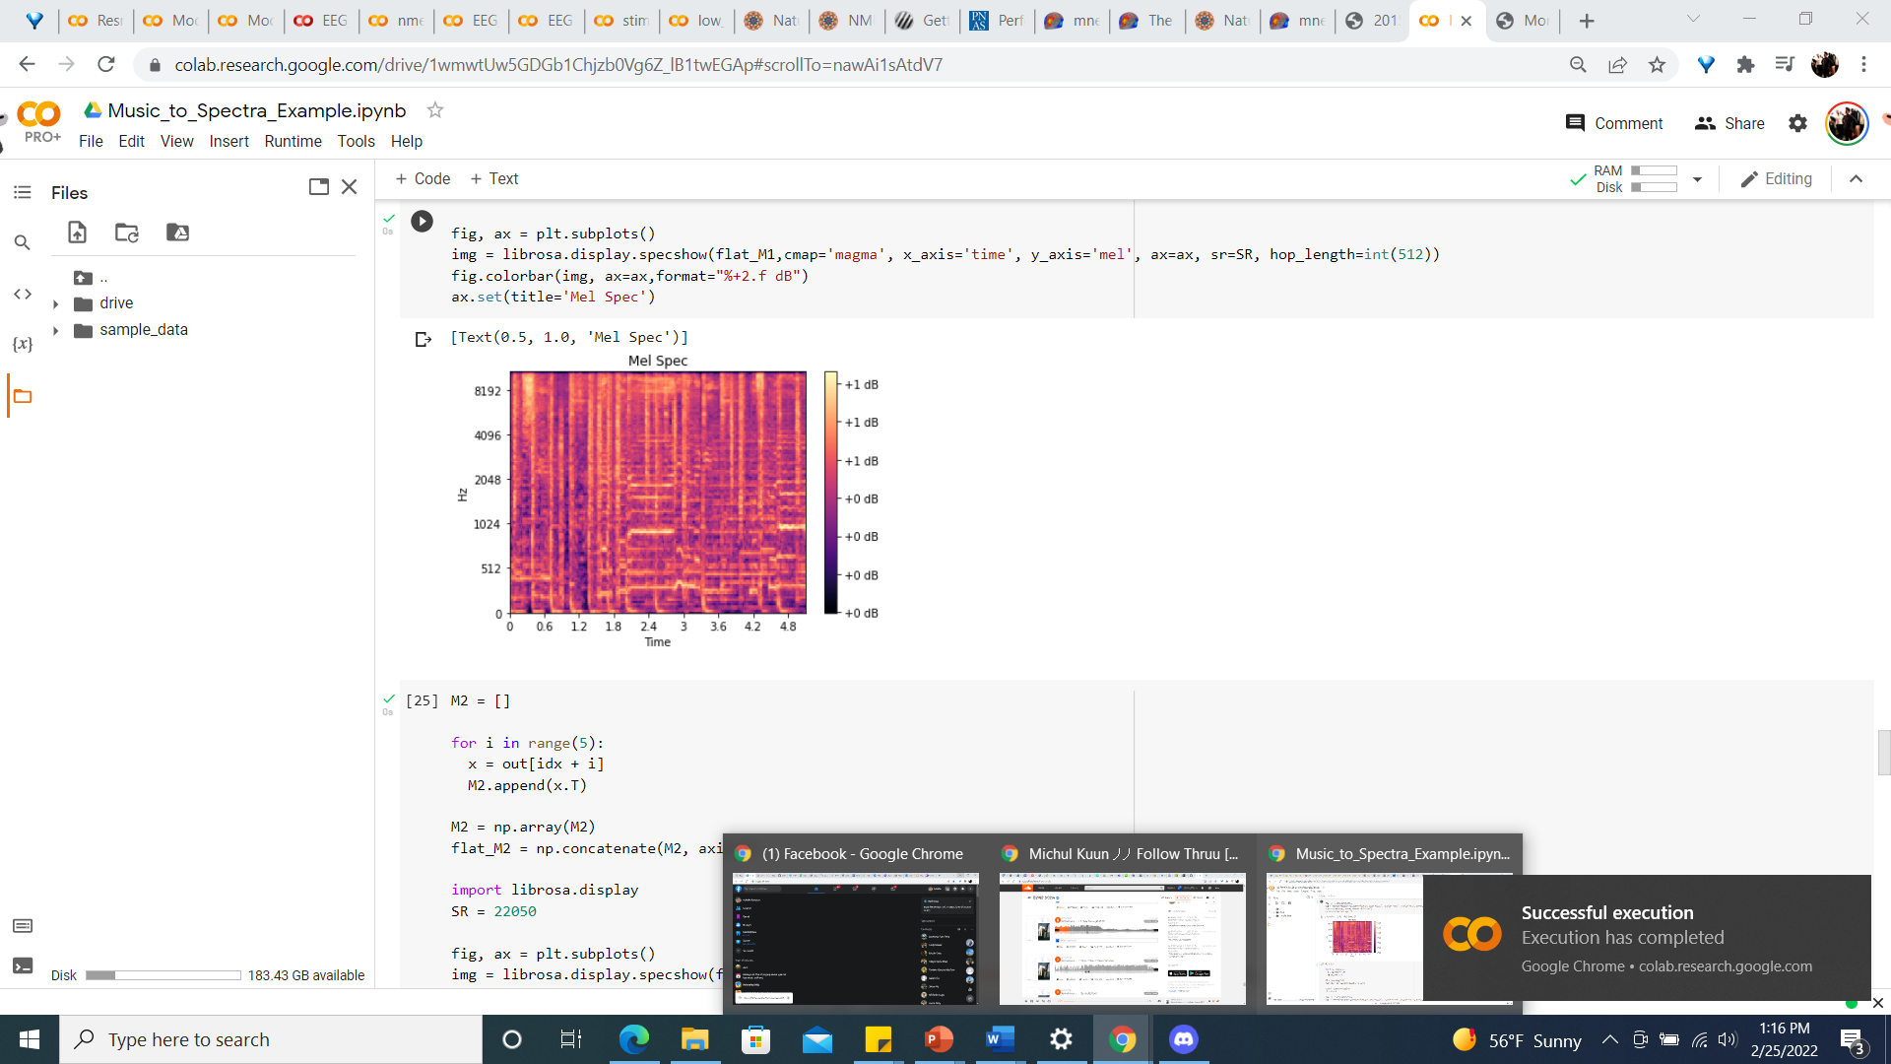
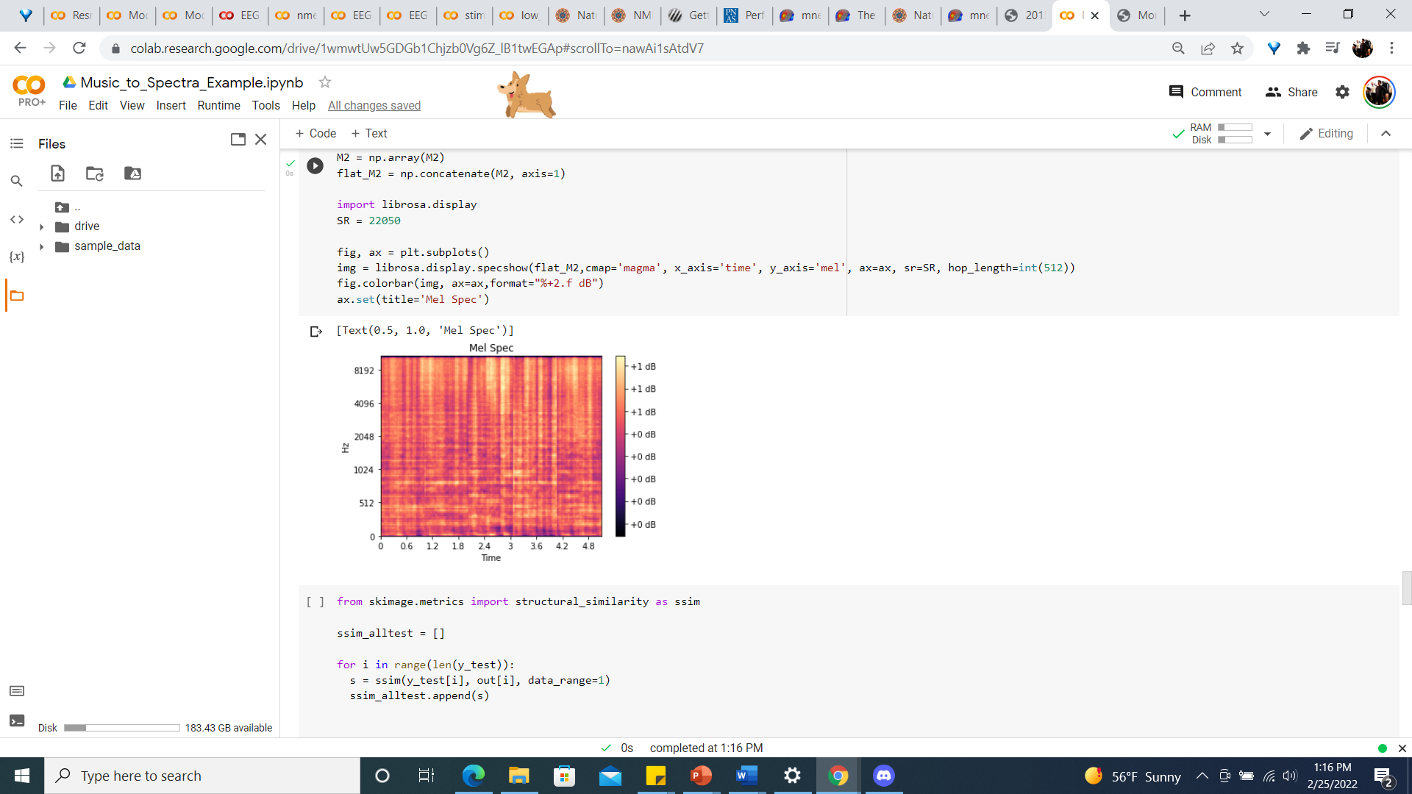
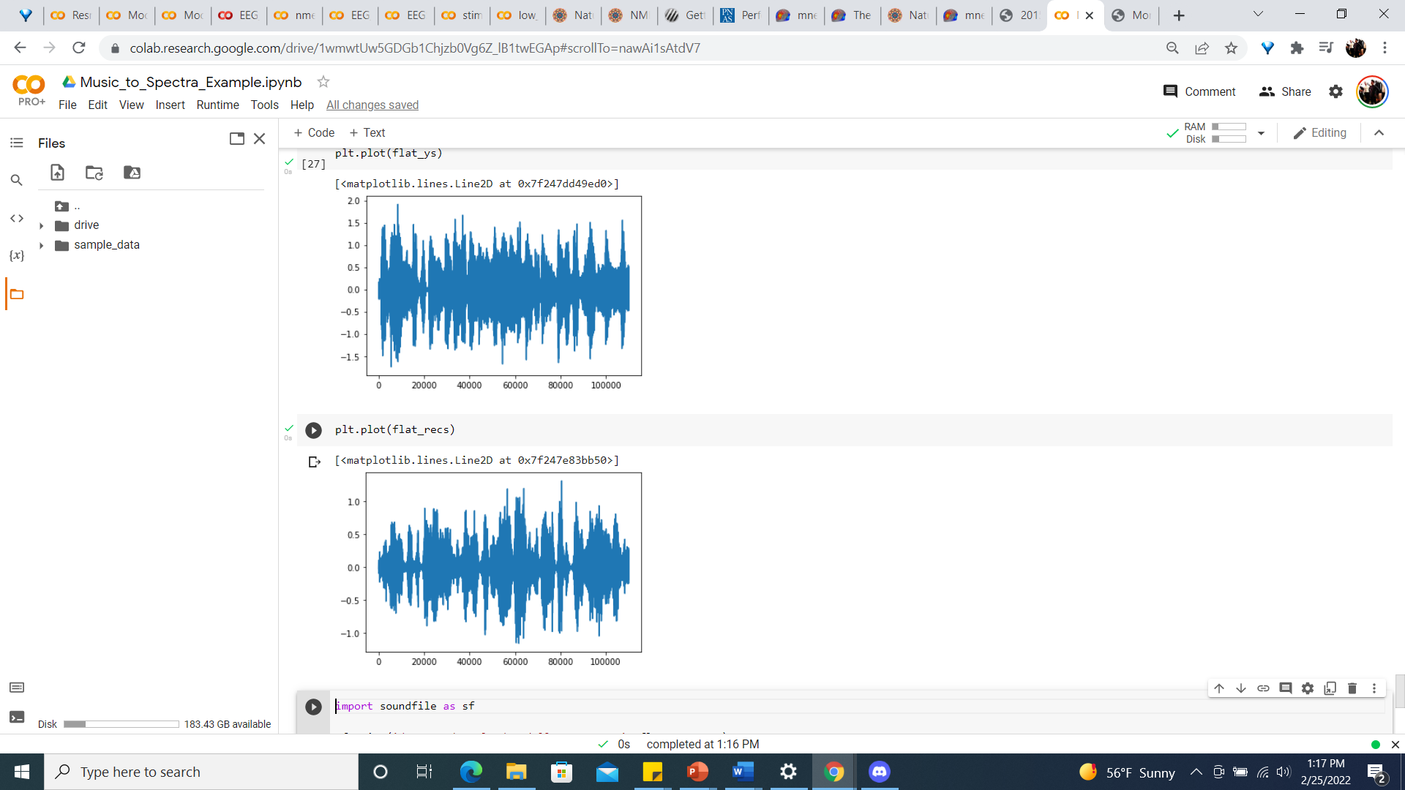
Stimuli
Model Reconstruction From Brain Response

Slide 10

SONG #3
Haule Haule -Sukhwinder Singh

Slide 11
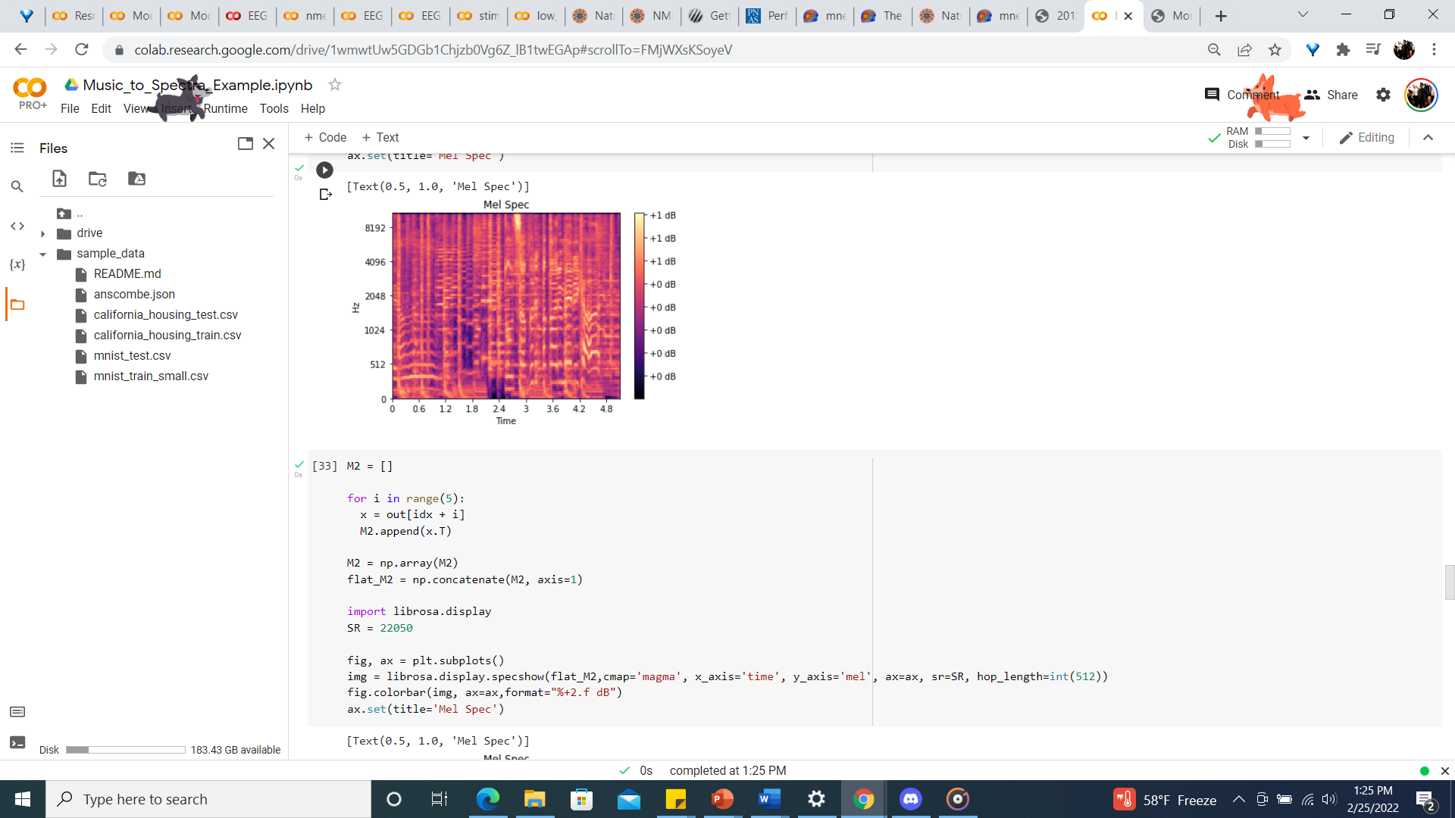
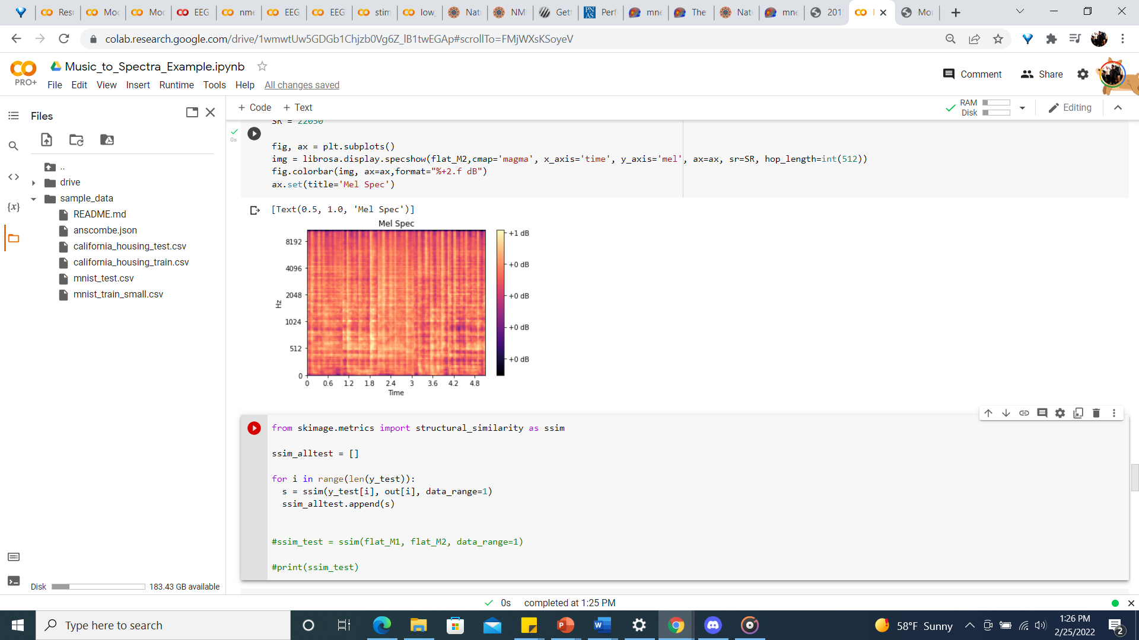
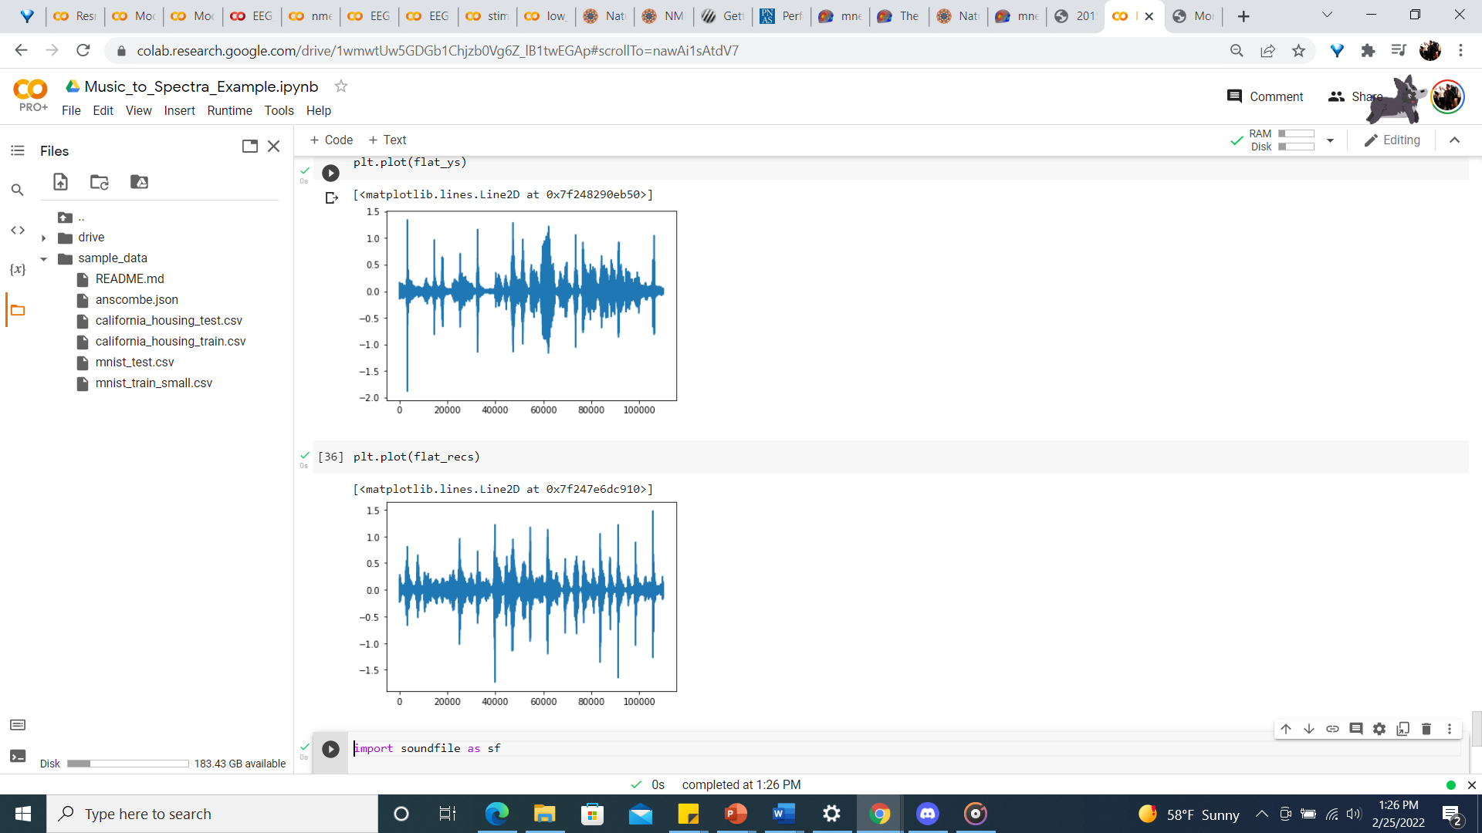
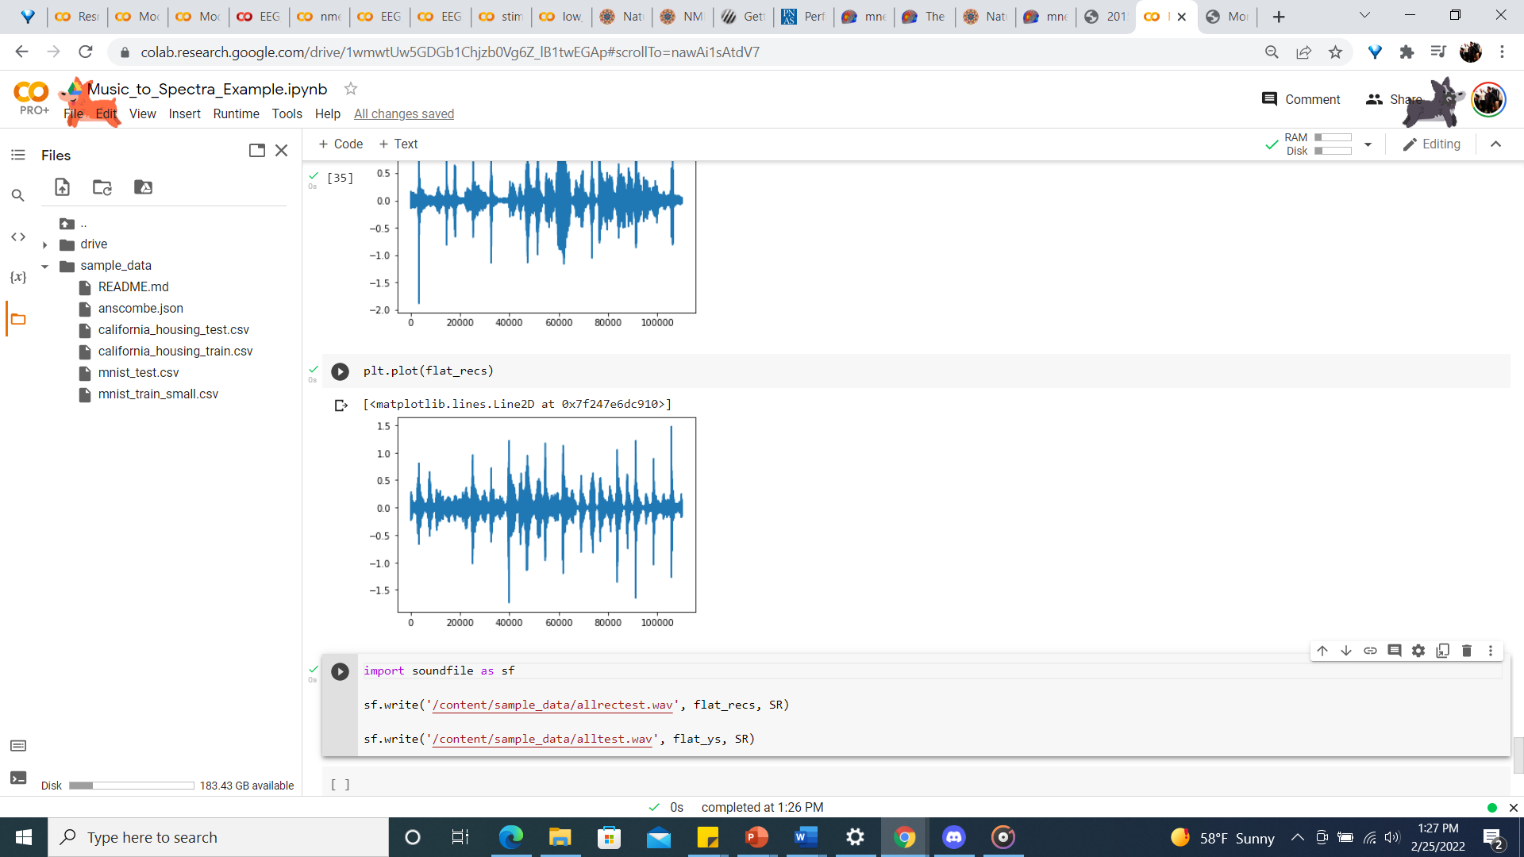
Stimuli
Model Reconstruction From Brain Response

Slide 12

SONG #4
Malang -Siddharth Mahadevan & Shilpa Rao

Slide 13
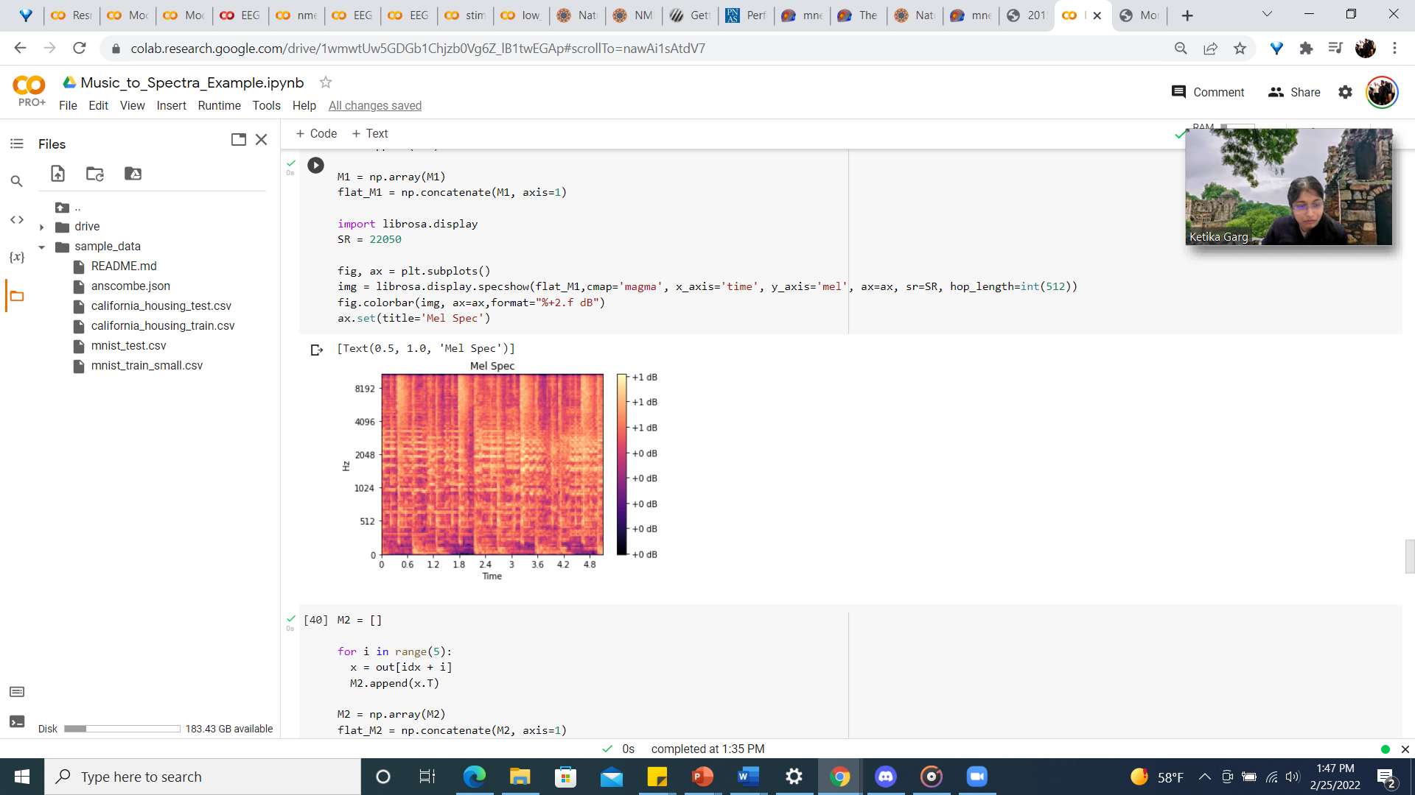
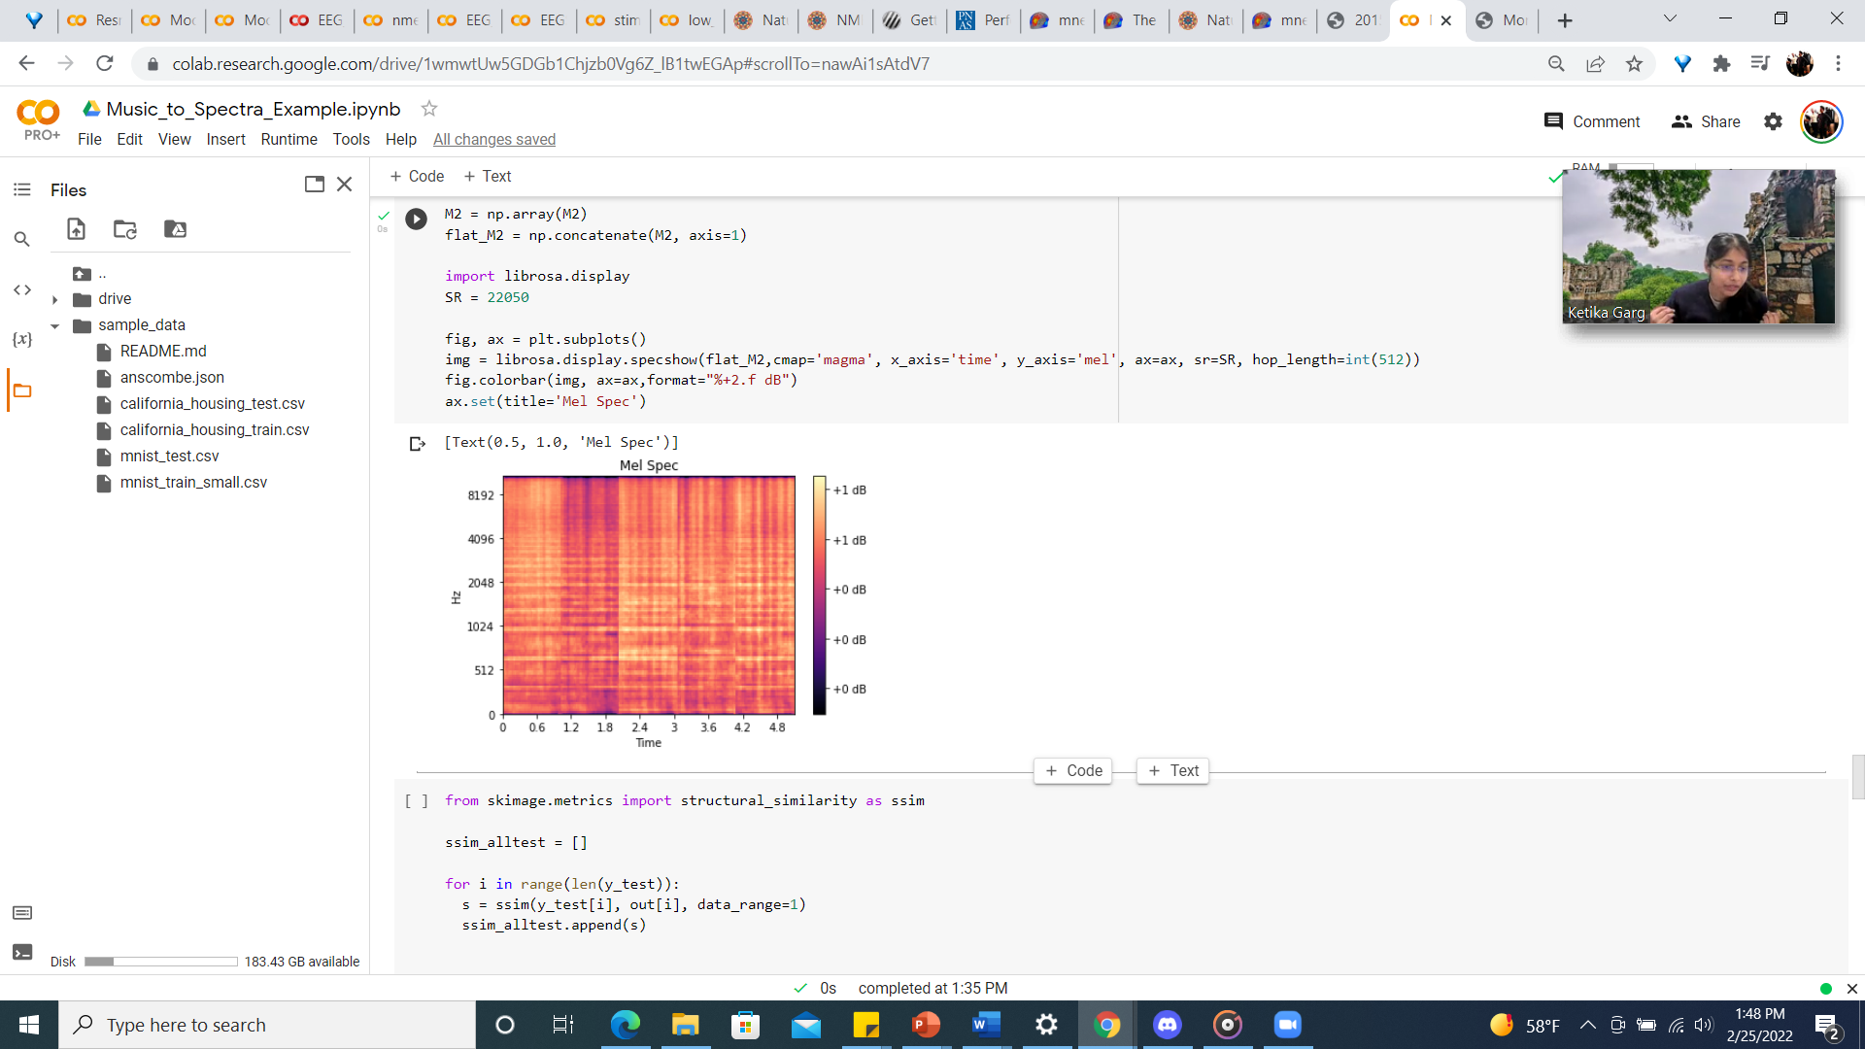
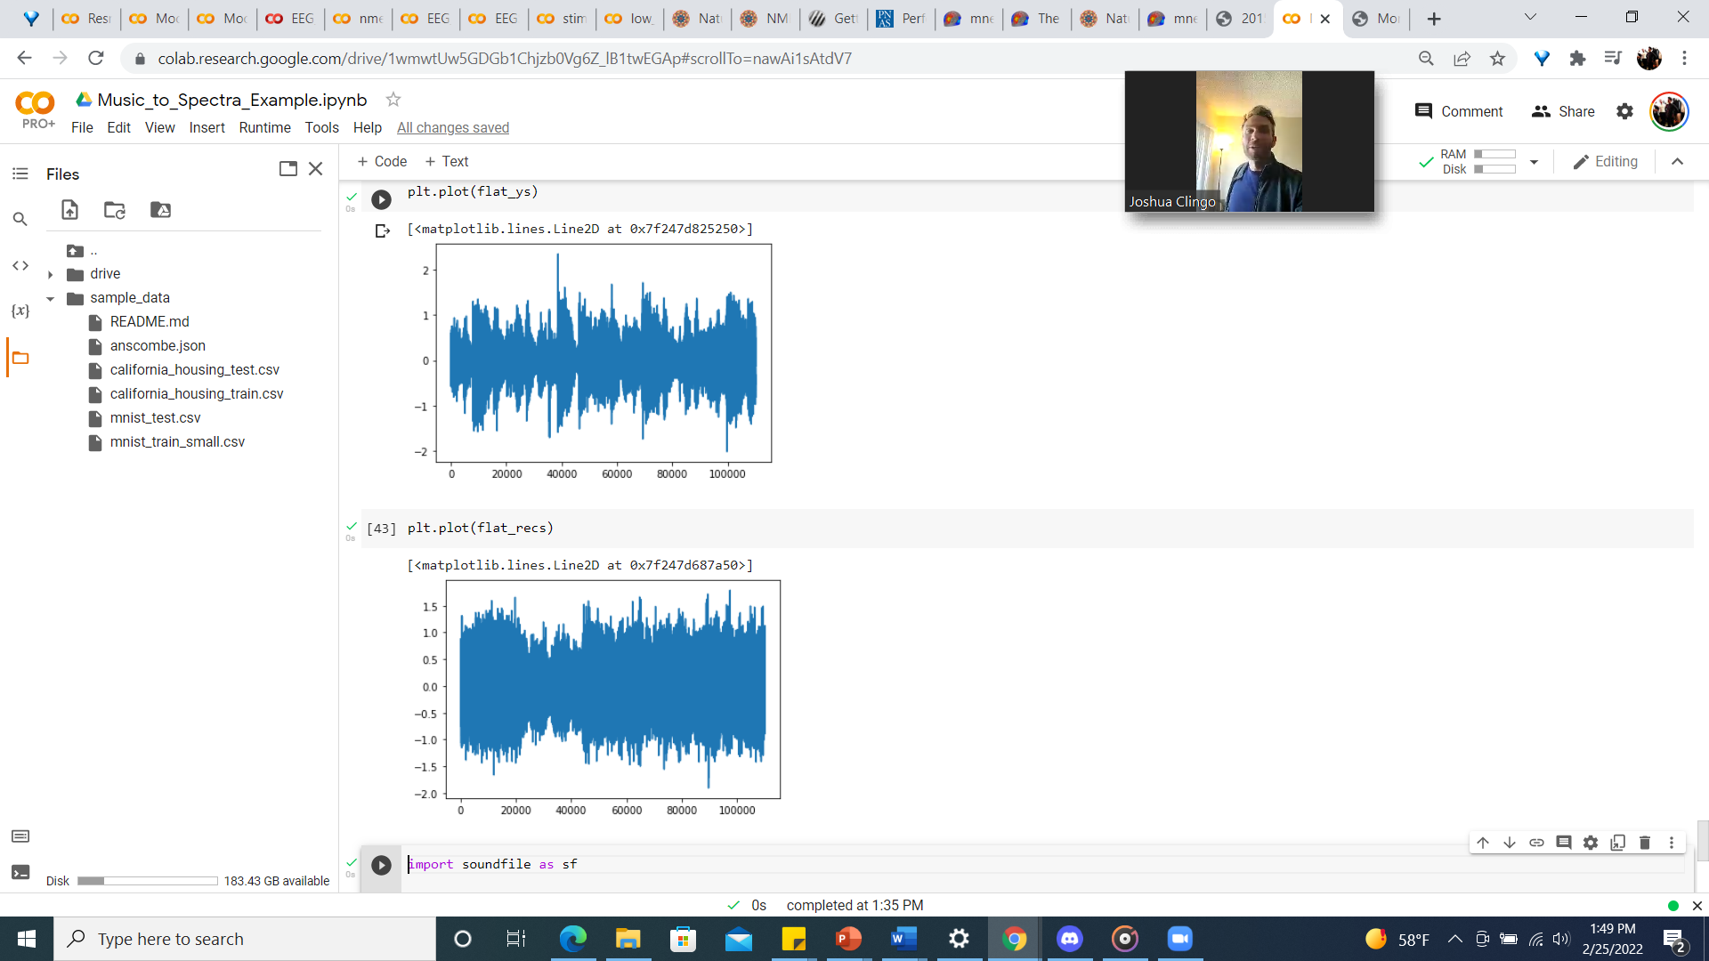
Stimuli
Model Reconstruction From Brain Response

